Slide 1
Kutty Port – The Zepto of Indian Export Logistics
THINk global, ship local – kutty port
Team Bloopers
The Pivot Challenge

Slide 2

BLOOPERS PRESENTS
KUTTY-PORT
Name:-Parthiban G Email:-727823tuio035@skct.edu.in College:-Sri Krishna College Of Technology
Name:-Ponmadhan D Email:-727823tuio037@skct.edu.in College:-Sri Krishna College Of Technology
Name:-Prem S Email:-727823tuio039@skct.edu.in College:-Sri Krishna College Of Technology
Name:-Shakhib Akthar S Email:-727823tuio035@skct.edu.in College:-Sri Krishna College Of Technology

Slide 3
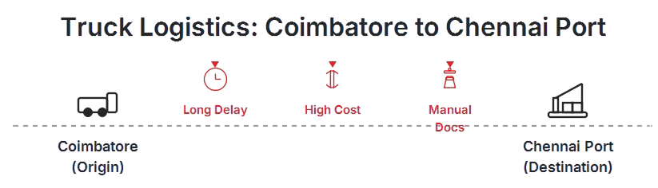
The Core Problem: Why Ports Are a Bottleneck
• Centralized ports are overwhelmed, leading to delays.
• MSMEs suffer from high logistics costs due to lack of consolidation.
• Short-distance exports (<300 km) pay disproportionately high fees.
• Manual documentation delays clearance.
• Real-time tracking is absent.
For example:- Coimbatore-to-Chennai Exporters Pay ₹22k for a small exporter.
Fig 1: Truck Logistics(CBE-CHE)

Slide 4
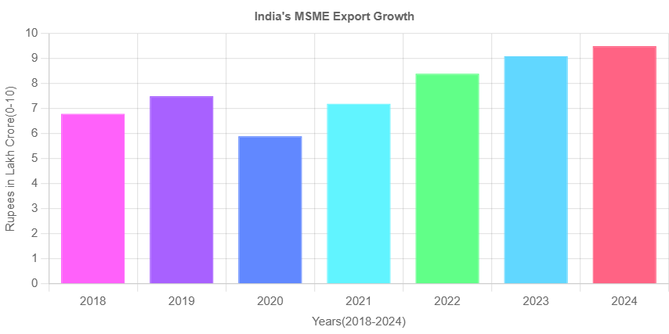
Post-COVID Disruption: MSMEs Surge, Infra Stagnant
MSME exports have grown over 40% since 2019.
Existing port infrastructure hasn’t scaled accordingly.
Labor shortages, container backlogs, and digital gaps persist.
MSMEs are now major contributors but remain underserved.
Fig 2: Graph of MSME Export Growth

Slide 5
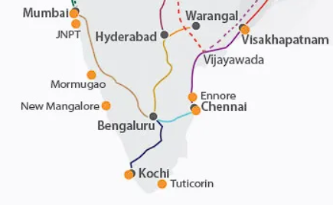
Kutty Port: A Decentralized Port Microhub Network
• Small logistics hubs within 100–300 km of major ports.
• Aggregates goods from local exporters.
• Shared container dispatch to central ports daily.
• API-driven customs clearance + digital paperwork.
• Real-time tracking via mobile/web dashboard.
Fig 3: South India Logistics

Slide 6
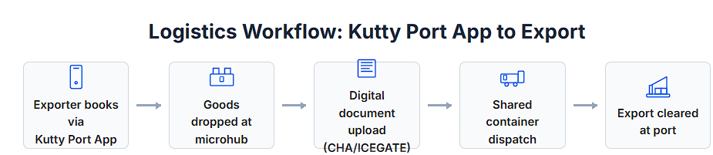
Proof of Concept: Export Workflow Example
Exporter books via Kutty Port App.
Drops goods at nearest Kutty Port hub.
Digital documentation (ICEGATE/CHA integration).
Shared container dispatch to main port.
Export cleared and sent abroad.
📍 Example: Tiruppur to Chennai Port – Cost down to ₹8K from ₹24K.
Fig 4: Export Workflow Of Kutty-Port

Slide 7
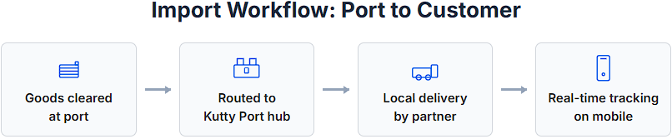
Proof of Concept: Import Workflow Example
1. Importer chooses nearest Kutty Port.
2. Container clears customs at port.
3. Delivery routed to Kutty Port hub.
4. Local delivery via partner (e.g., Dunzo, Delhivery).
5. Real-time tracking till last mile.
Fig 4: Import Workflow Of Kutty-Port

Slide 8
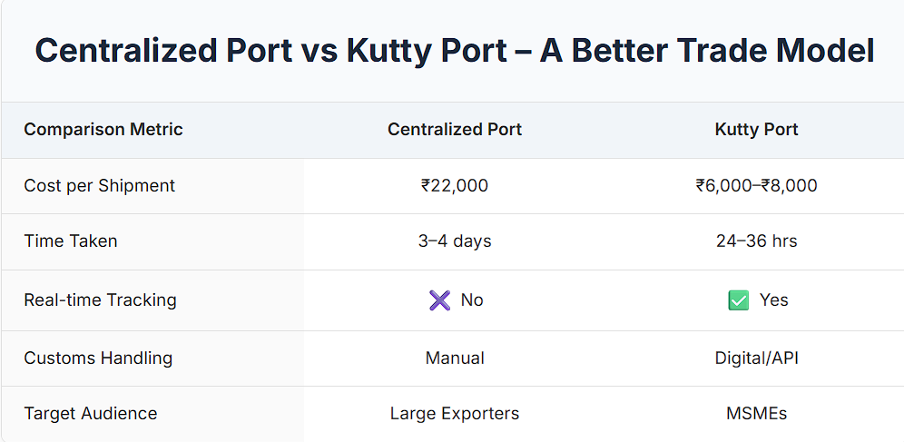
Centralized vs Kutty Port: Value Comparison
Example Comparison How Our Kutty Port Differs From Centralized Port
Fig 5: Comparison of Centralized port And Kutty-Port

Slide 9
Tech Stack: UI, UX, and Platform Architecture
• Mobile App: Exporter/Importer slot booking, document upload, live tracking.
• Web Dashboard: Admin and logistics control.
• API Integration: ICEGATE, CHA, GPS tracking, route optimization.
• UX: Simple 3-step interface, bilingual (English + regional).
• UI Sample: Minimalistic layout showing shipment stages visually.

Slide 10
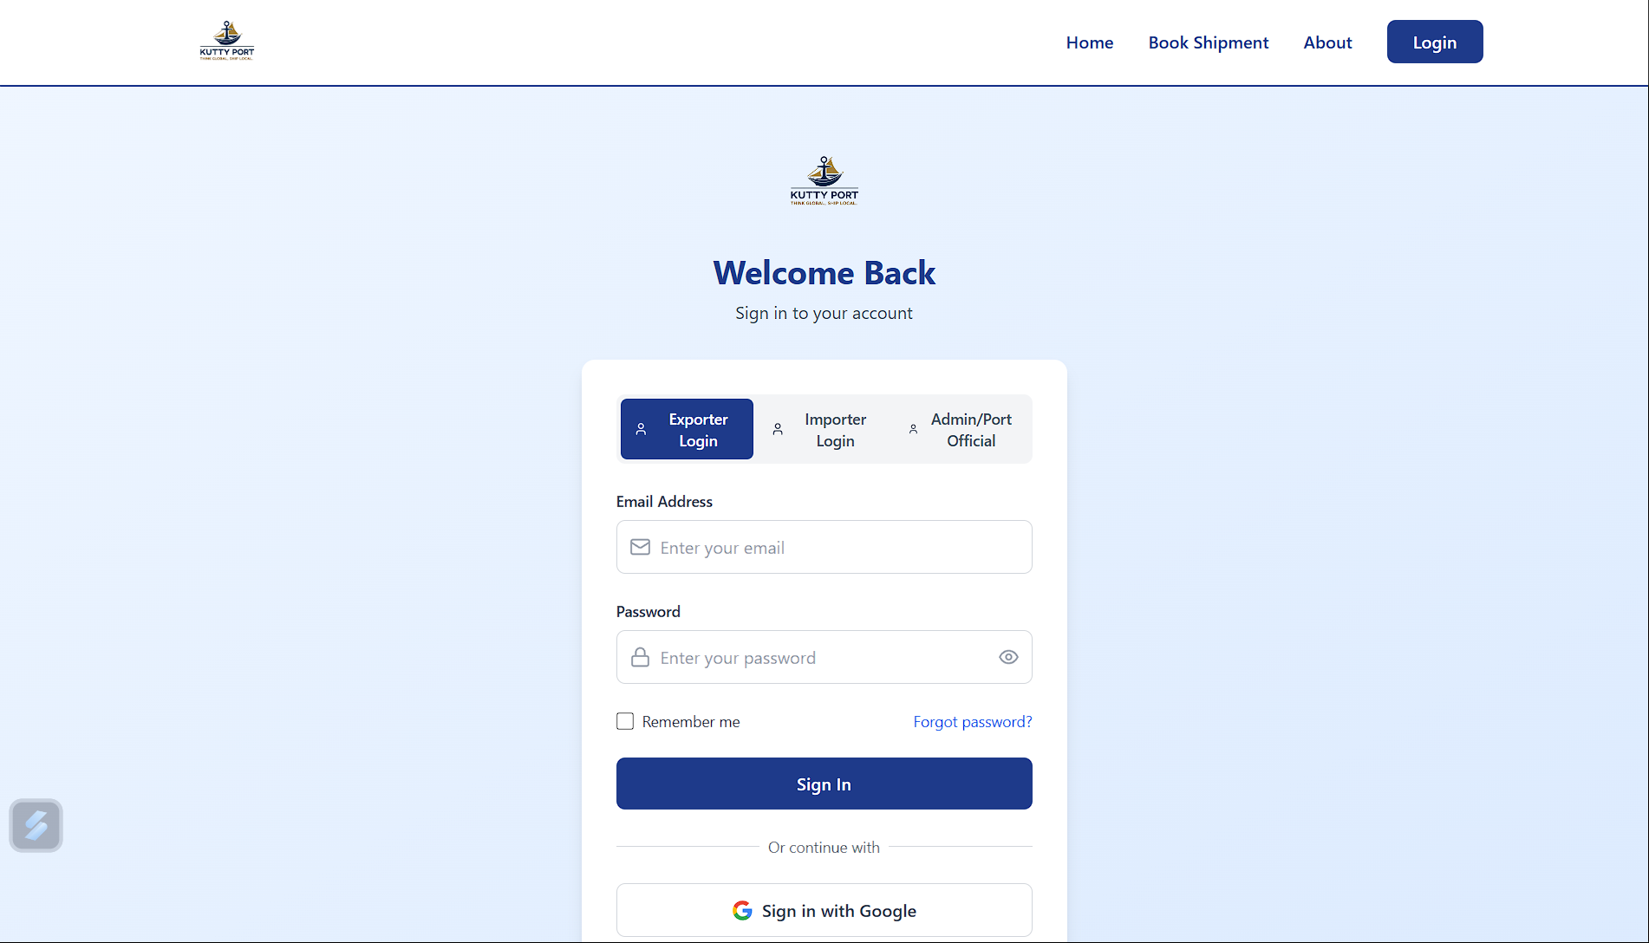
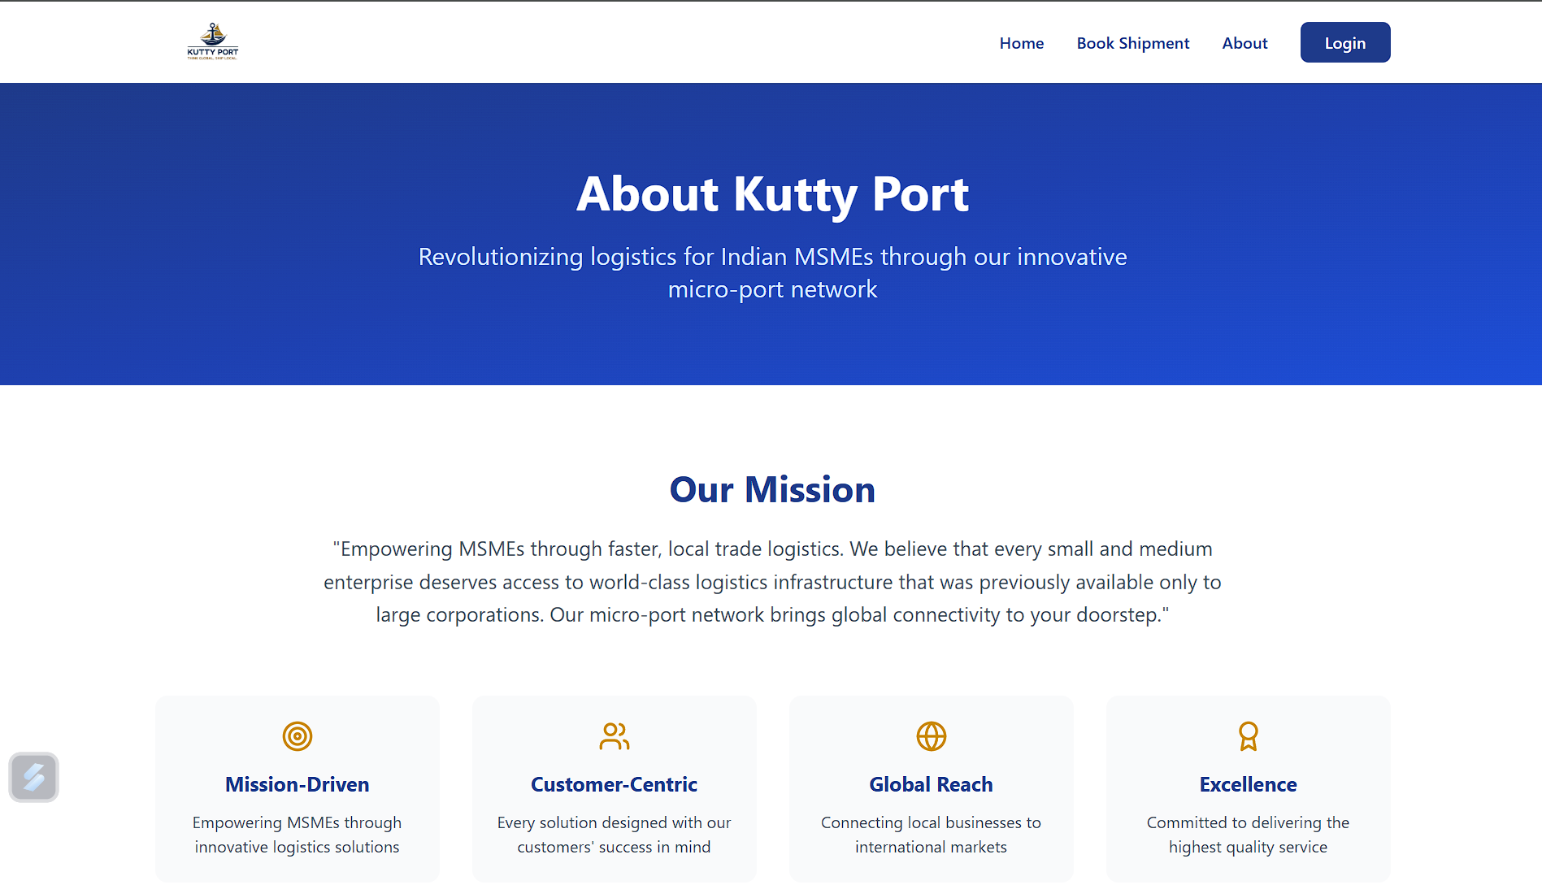
The Digital Face of Kutty Port
About Page
Platform Login UI

Slide 11
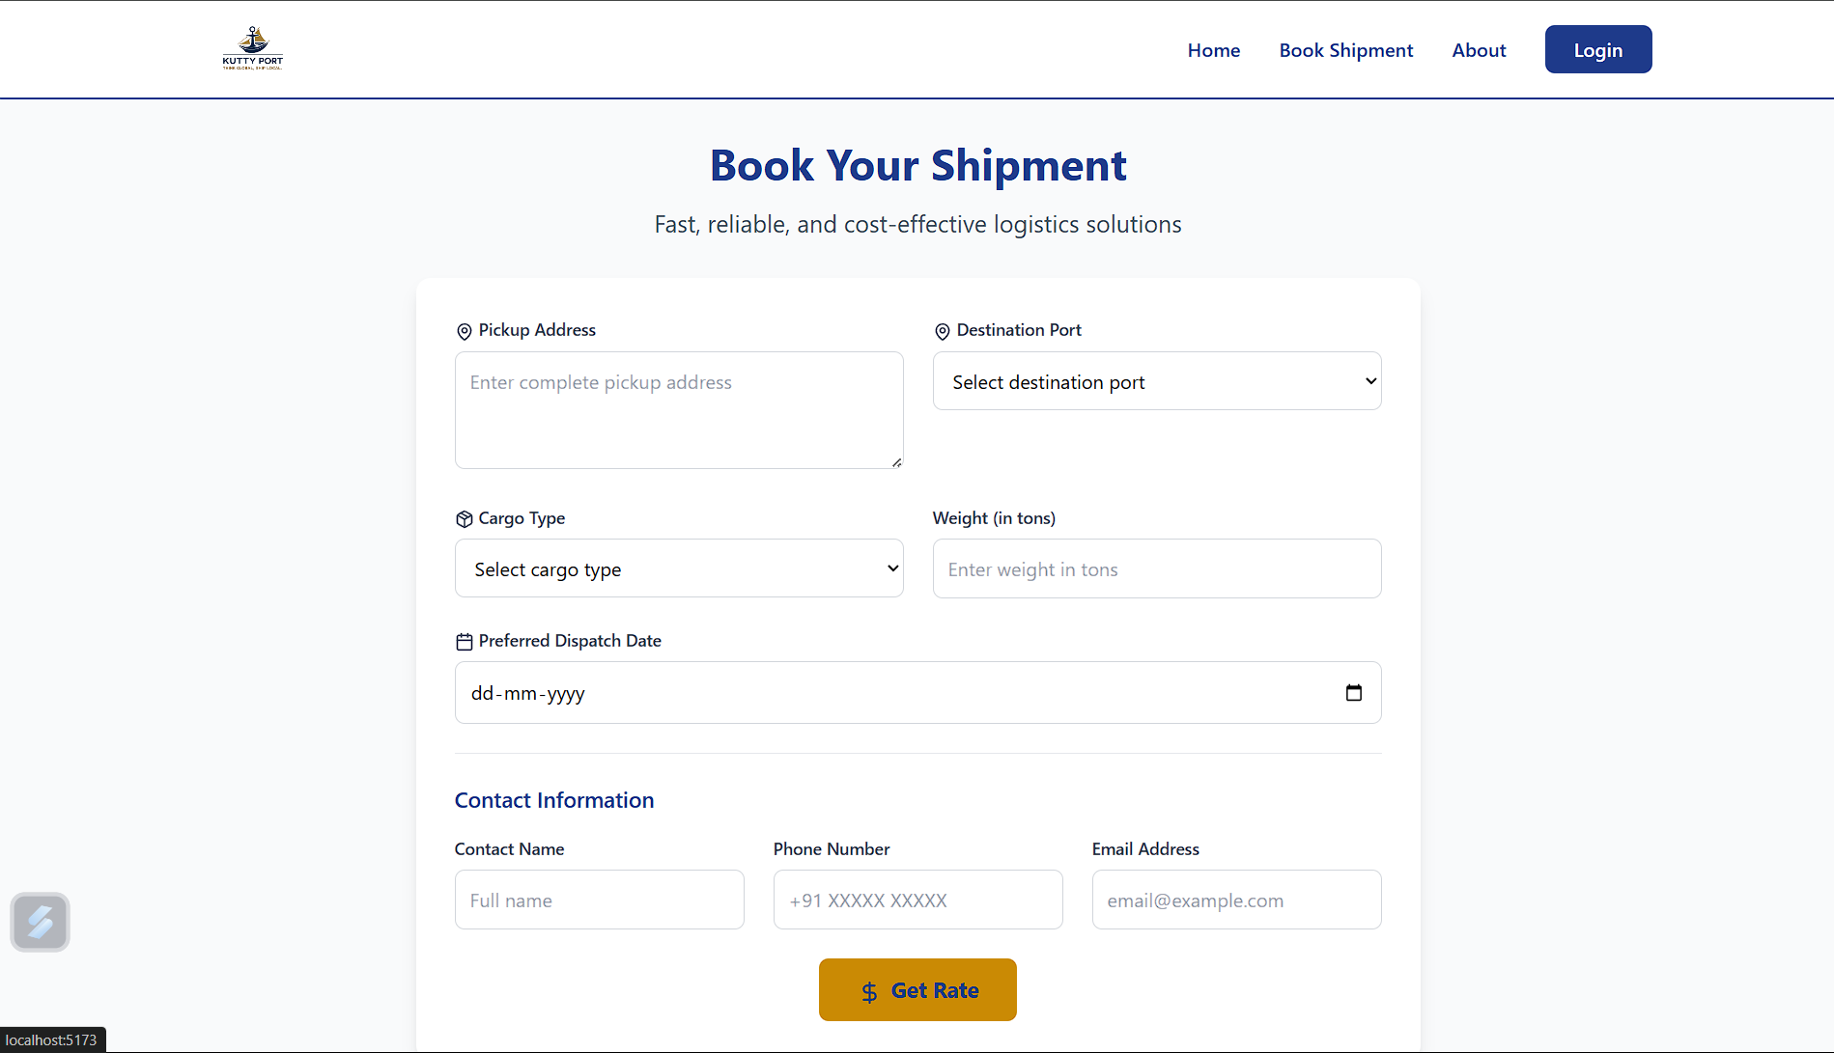
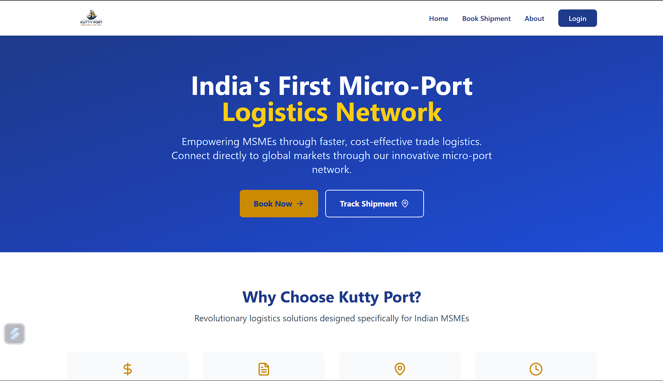
Our Platform: Simple, Secure, Scalable
Home Page
Dashboard Preview

Slide 12
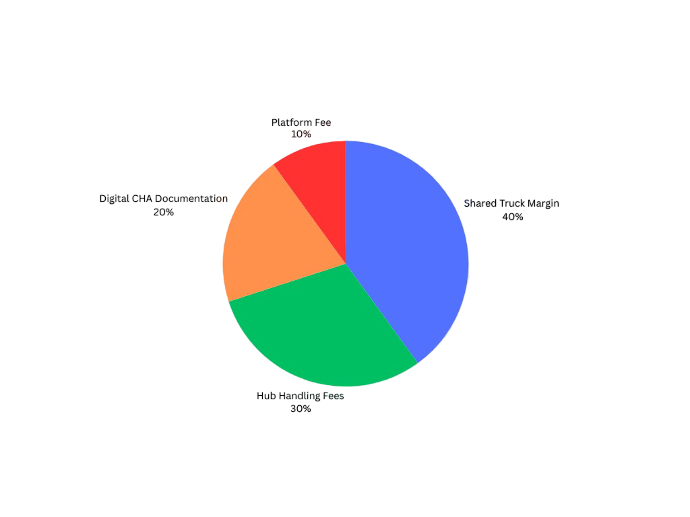
Business Model & Revenue Streams
• Hub Handling Fees: ₹500–₹1,000
• Shared Trucking Margins: ₹800–₹1,500
• Digital CHA Documentation: ₹200–₹400
• Platform Tech Fee: Flat ₹250/shipment
• Scalable per city – earns on volume & efficiency.
Fig 4: Pie Chart Of Business model and Revenue

Slide 13
What’s Next for Kutty Port?
Expansion to Multiple States
Electric trucks + drone last-mile delivery.
Exporter financing & insurance integration.
Building ‘India’s first MSME port grid’.
ONDC Logistics tie-up.

Slide 14
Thank you
Let’s Build This Together
Kutty Port is Waiting for its deployment
We seek: Mentorship, Seed Support, Tech-Infra Collaboration.
Empowering Bharat’s MSMEs — one hub at a time.

